Slide 1
Filter Method Ensemble with Neural Networks
NAME: ANURAN CHAKRABORTY
ROLL: 001610501020
BCSE-IV

Slide 2
AGENDA
Introduction
Filter Methods
Proposed Method
Results
Conclusion

Slide 3
INTRODUCTION
Multiple classifier systems can often provide better results compared to single classifier systems[1][2].
A two-level neural network ensemble method has been proposed here.
Three different feature sets have been obtained using filter methods.
This method is from the paper “Filter Method Ensemble with Neural Networks”, A. Chakraborty, R. Dey, A. Chatterjee, F. Schwenker, R.Sarkar, ICANN 2019.

Slide 4
FILTER METHODS
In filter methods the selection of features are independent of any machine learning algorithms
Filter methods used :
Chi-square
Mutual Information
ANOVA F-test

Slide 5
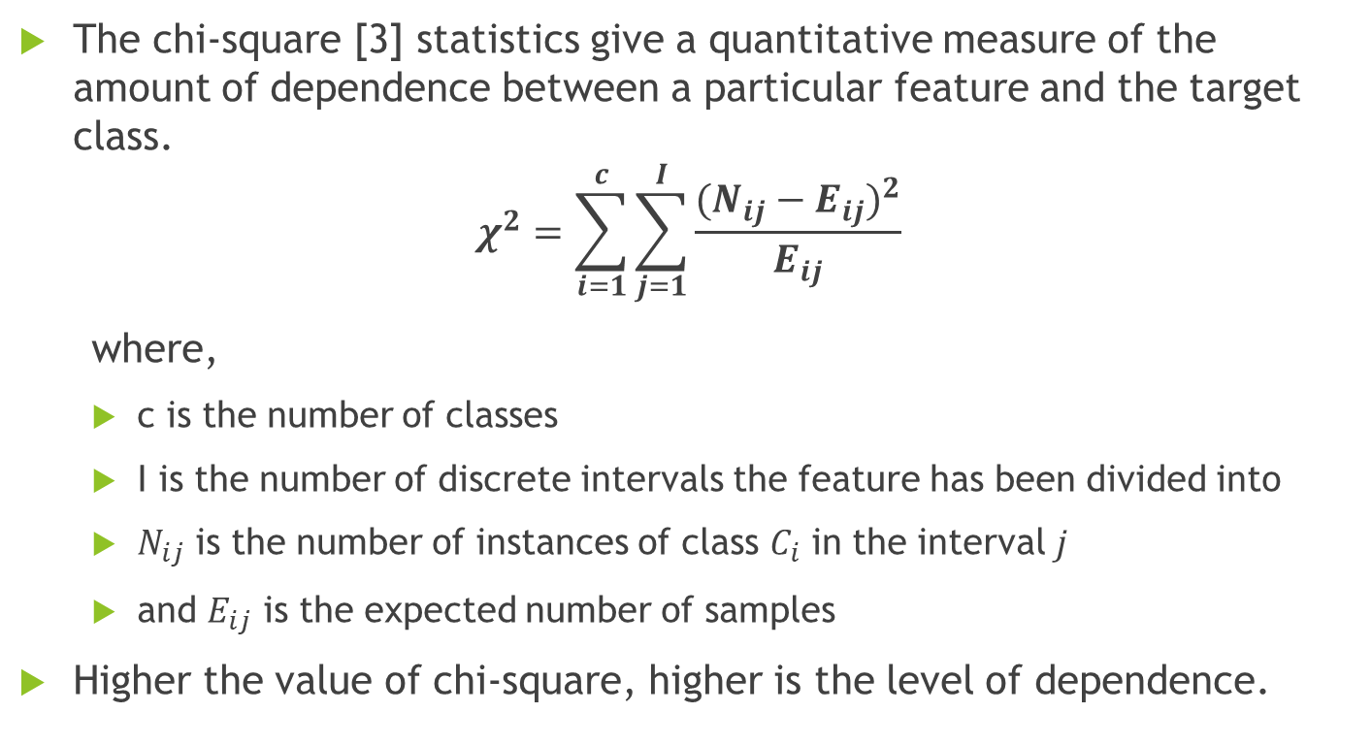
CHI-SQUARE
The chi-square [3] statistics give a quantitative measure of the amount of dependence between a particular feature and the target class.
$$χ^{2}=\sum_{i=1}^{c}{\sum_{j=1}^{I}{\frac{{(N_{ij}−E_{ij})}^{2}}{E_{ij}}}}$$
where,
c is the number of classes
I is the number of discrete intervals the feature has been divided into
$N_{ij}$ is the number of instances of class $C_{i}$ in the interval $j$
and $E_{ij}$ is the expected number of samples
Higher the value of chi-square, higher is the level of dependence.

Slide 6
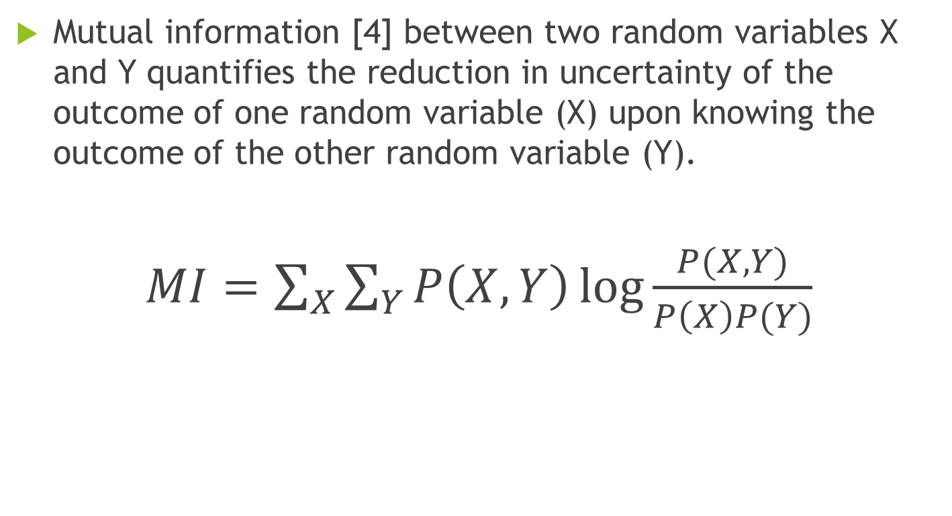
MUTUAL INFORMATION
Mutual information [4] between two random variables X and Y quantifies the reduction in uncertainty of the outcome of one random variable (X) upon knowing the outcome of the other random variable (Y).
$MI=\sum_{X}{\sum_{Y}{P\left(X,Y\right)\log{\frac{P(X,Y)}{P\left(X\right)P(Y)}}}}$

Slide 7
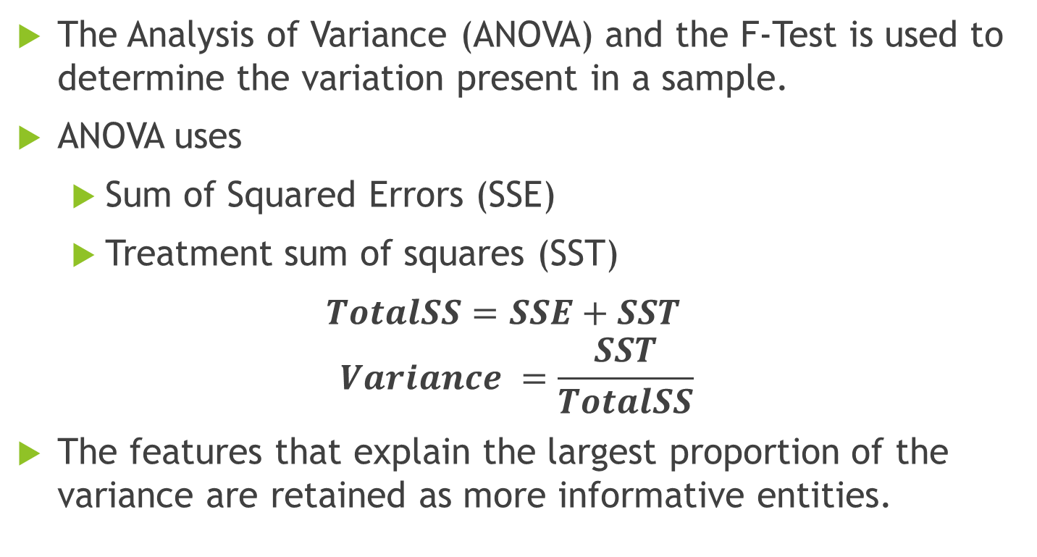
ANOVA F-TEST
The Analysis of Variance (ANOVA) and the F-Test is used to determine the variation present in a sample.
ANOVA uses
Sum of Squared Errors (SSE)
Treatment sum of squares (SST)
$TotalSS=SSE+SST$
$$Variance =\frac{SST}{TotalSS}$$
The features that explain the largest proportion of the variance are retained as more informative entities.

Slide 8
PROPOSED MODEL
In the proposed method the dataset is first split into 3 parts, namely:
Train Set
Validation Set
Test Set
The final testing is done on the test set.

Slide 9
PROPOSED METHOD: FEATURE SELECTION
Feature selection is performed on the train set
Select k features using chi2.
Train Set
Select l features using MI.
Select m features using ANOVA F-Score.

Slide 10
PROPOSED METHOD: TRAINING
k selected features using chi2
Train MLP1
l selected features using MI
Train MLP2
m selected features using ANOVA F
Train MLP3

Slide 11
PROPOSED METHOD: VALIDATION
Trained MLP1
Class Membership Score M1
Validation Set
Trained MLP2
Class Membership Score M2
Trained MLP3
Class Membership Score M3

Slide 12
PROPOSED METHOD: ENSEMBLE
M1
M2
M=[M1 M2 M3]
Train MLP4
M3

Slide 13
RESULTS
The method has been tested on 5 UCI Repository datasets.
Name of dataset | Number of features selected |  |  | Average Accuracy (%)
 | Chi2 | ANOVA F-Test | MI | MLP1 | MLP2 | MLP3 | Proposed Ensemble
Arrhythmia | 20 | 10 | 30 | 60.52 | 52.31 | 54.50 | 63.30
Ionosphere | 20 | 20 | 20 | 89.86 | 91.55 | 91.55 | 94.36
Hill-Valley | 50 | 50 | 50 | 51.11 | 55.31 | 51.60 | 60.74
Waveform | 20 | 20 | 20 | 86.38 | 87.08 | 87.16 | 86.83
Horse Colic | 6 | 6 | 6 | 85.41 | 88.10 | 87.30 | 88.65

Slide 14
RESULTS: A COMPARISION

Slide 15
CONCLUSION
The proposed ensemble is more robust than all of the others.
The neural network ensemble learns to spot many dependencies which may not have been possible by manual tuning.
Future Scope
More classifiers with different working principles may be used instead of only MLP.

Slide 16
REFERENCES
Dietterich, T.G.: Ensemble Methods in Machine Learning, Multiple Classifier Systems. pp. 1–15. Springer Berlin Heidelberg, Berlin, Heidelberg (2000). https://doi.org/10.1007/3-540-45014-9_1.
Kittler, J., Hatef, M., Duin, R.P.W., Matas, J.: On combining classifiers. IEEE Trans. Pattern Anal. Mach. Intell. 20, 226–239 (1998). https://doi.org/10.1109/34.667881.
Jin, X., Xu, A., Bie, R., Guo, P.: Machine learning techniques and chi-square feature selection for cancer classification using SAGE gene expression profiles, Lecture Notes in Computer Science. pp. 106–115. Springer Berlin Heidelberg, Berlin, Heidelberg (2006). https://doi.org/10.1007/11691730_11.
Uğuz, H.: A two-stage feature selection method for text categorization by using information gain, principal component analysis and genetic algorithm, Knowledge-Based Syst. 24, 1024–1032 (2011).

Slide 17
THANK YOU

